Slide 1

Custom Golf Ball Shop
Using React-Three-Fiber

Slide 2

Background
My cousin has a startup idea where he can 3D print custom patterns onto golf balls
Current methods have bad interfaces and poor customizability
Without him knowing, I took this idea and decided to make a website about it for my final project

Slide 3
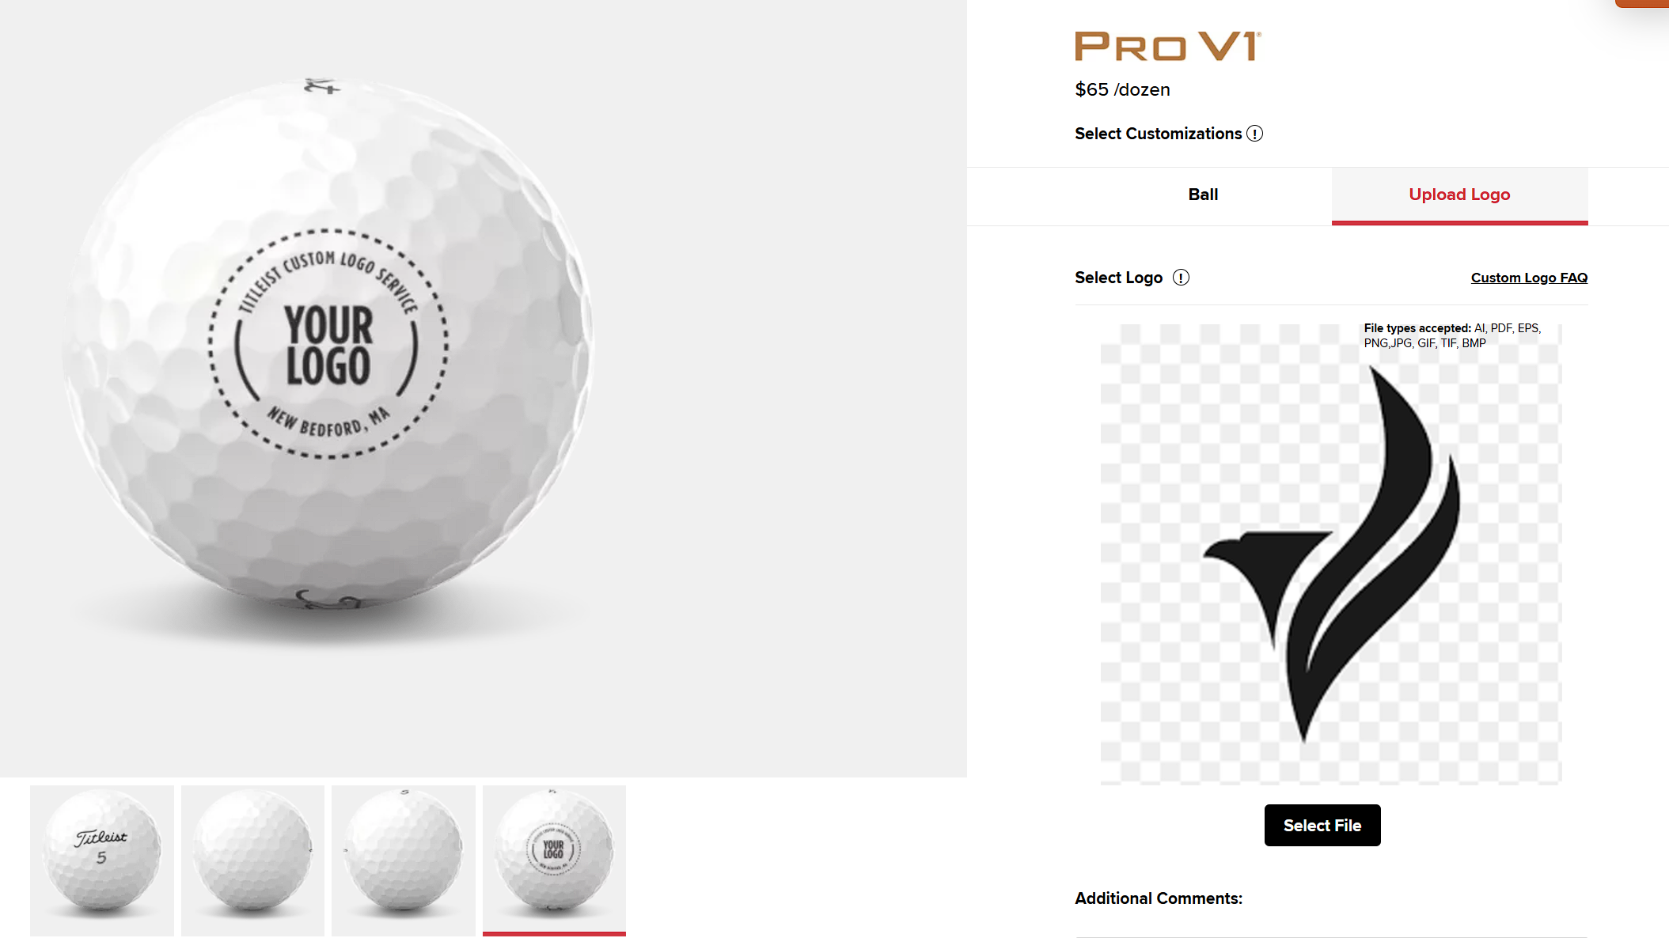
The Current Options
On Titleist’s website, they have an option to customize, but it’s not very good

Slide 4

Architecture
For this project, we initialized a Vite project with React-Three-Fiber
Vite is a modern build tool that provides fast development and optimized production builds
Offering an ideal environment for React and Three.js development with minimal setup
For styling, we went with TailwindCSS
In-line utility-based styling framework
I used it in previous projects and liked it – good online community
Very nice to work with – can spin up good looking apps very quickly
Reusable custom attributes using layering
Used extensively in industry – good practice

Slide 5
Why We Chose React
After learning it in class, we really liked the reusable component aspect of the framework
Huge ecosystem
Tools available for us to use Three.js with React
Allowed us to turn 3D models into react components
Gives all the tools normally accessible to React components
React-Router-DOM
Easily setup Routes for a SPA
Let’s us save component state between pages
Better user Experience

Slide 6

R3F Under the Hood
WebGL allows websites to render 3D models
Takes advantage of graphics processors
Three.js is the first layer of abstraction, allowing developers to more effectively develop with 3D models
R3F is an additional abstraction, allowing us to use all the React technologies we are used to with 3D models
Huge ecosystem of technologies, very refined technology
No additional overhead, all Three.js functionality is available

Slide 7
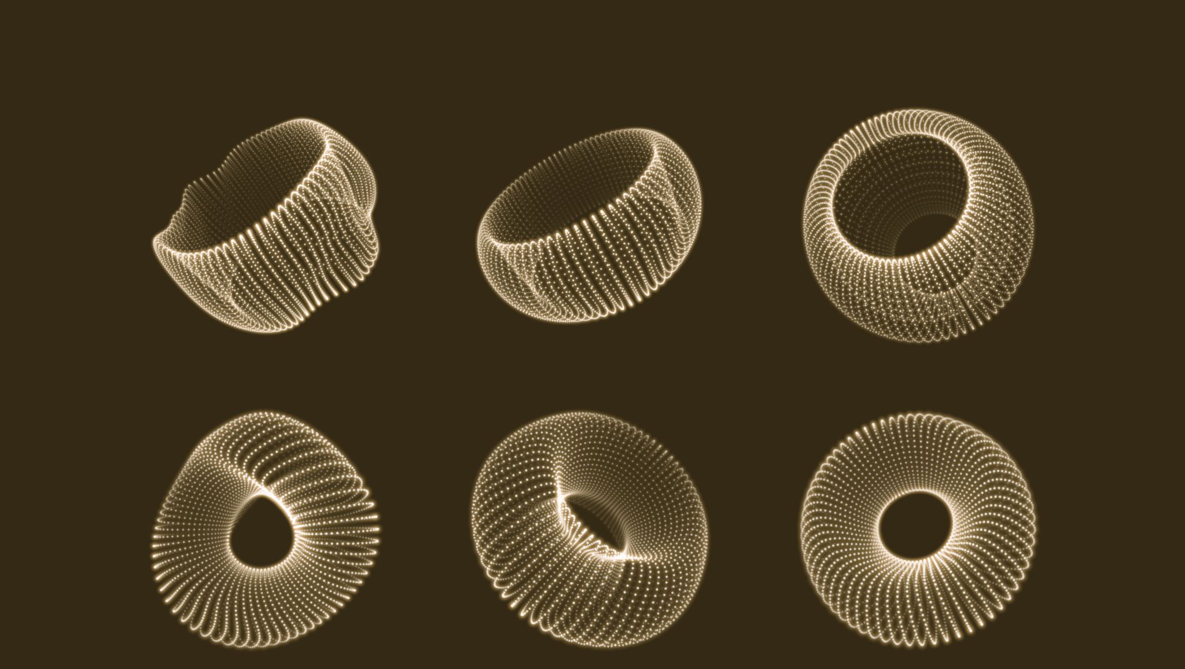
3D Models
Making your own 3D models is fine, but can be slow
Especially with more complex models
We decided to find free models on sketchfab
Finding free 3D models on sketchfab is great, but implementing by hand is pretty hard
Going through the GLB file, understanding the meshes, etc.
This led us to finding a website that does this part for you
R3F’s extensive community has created some great tools

Slide 8
GLTF → R3F
This website allows you to drag GLB files into and generates a working R3F component
Greatly reducing time spent integrating models
Allows us to repeatedly use the same model, as you’d expect from React Components
Can build off the generated model, allowing for customizability and unique functionality
Like adding certain qualities to the mesh
Color, images, etc.

Slide 9

How it Looks
After getting our model into R3F code, we can use it as a normal react component
Add props, adjust state, use repeatedly
Additionally, by accessing the material directly using Three.js, we can change how it looks
This is the basis of how we allowed user input to modify the model

Slide 10
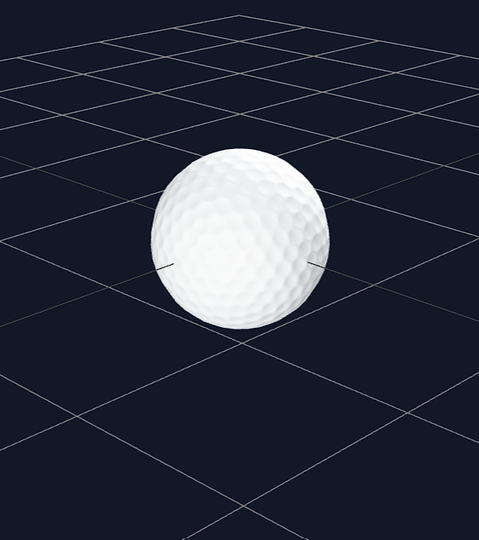
Position and Light
The hardest aspects:
Position – where the model shows up on the screen
Uses a 3D array [x, y, z]
Allows you to put the model anywhere on the canvas
Lighting – how you can actually see the model
Several types of lighting – we mostly use ambientLight (easiest)
Can save a lot of time by showing the grid: “<gridhelper args={[10, 10]} />”

Slide 11
React Hooks
The driving force behind modifying our R3F component
useState to set the brand, color, and logo based off user input
useNavigate to cache the modified model to send to the checkout page
useMemo to keep track of pricing adjustments

Slide 12
Demo

Slide 13
Struggles
Typically, 3D websites are static
Usually used for advertisements or portfolio websites
Most resources online didn’t have info on dynamically updating meshes
Even less had info on updating based on user input
Uploading files and resizing
We couldn’t find a way to allow the user to change the size of an image once it’s uploaded

